Slide 1

https://sahibulsaif.wordpress.com/wisdom/bismillah-nature/

Slide 2
Case study
CSC271 – DATABASE SYSTEMS

Slide 3
Previous Lecture Overview

Slide 4
Today’s Lecture
In this lecture, you will practice:
Drawing a complete ER Model of a real-life scenario.

Slide 5
College Case Study
Tiny College (TC) is divided into several schools: a school of business, a school of arts and sciences, a school of education, and a school of applied sciences. Each school is administered by a dean who is a professor. Each professor can be the dean of only one school, and a professor is not required to be the dean of any school.
Notes:
1:1 relationship exists between PROFESSOR & SCHOOL. Cardinality can be expressed by writing (1,1) next to the entity PROFESSOR and (0,1) next to the entity SCHOOL.

Slide 6
College Case Study
Each school comprises of several departments. For example, the school of business has an accounting department, a management/marketing department, an economics/finance department, and a computer information systems department.
On the other hand, each department belongs to only a single school; thus, the cardinality is expressed by (1,1). That is, the minimum number of schools that a department belongs to is one, as is the maximum number.
Notes:
Note: The smallest number of departments operated by a school is one, and the largest number of departments is indeterminate (N).

Slide 7
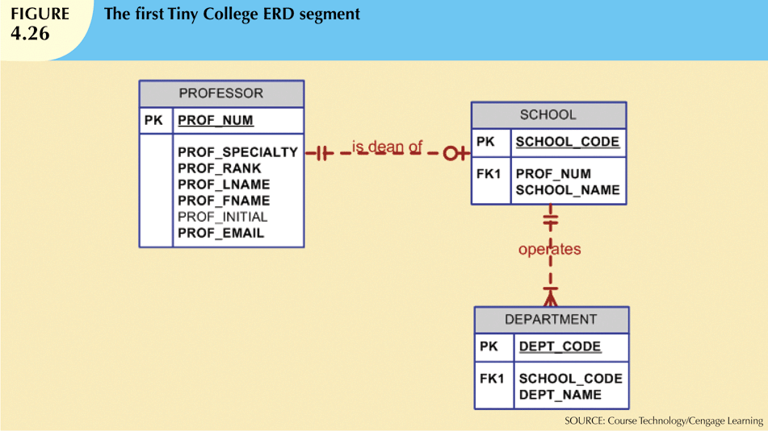

Slide 8
College Case Study
Each department may offer courses. For example, the management/marketing department offers courses such as Introduction to Management, Principles of Marketing, and Production Management. Note that this relationship is based on the way Tiny College operates. If, for example, Tiny College had some departments that were classified as “research only,” those departments would not offer courses; therefore, the COURSE entity would be optional to the DEPARTMENT entity.

Slide 9
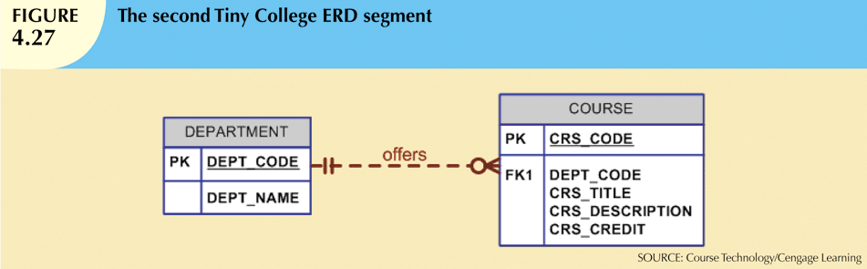
College Case Study

Slide 10
College Case Study
Each department should have one or more professors assigned to it. One and only one of those professors chairs the department, and no professor is required to accept the chair position. Therefore, DEPARTMENT is optional to PROFESSOR in the “chairs” relationship.

Slide 11
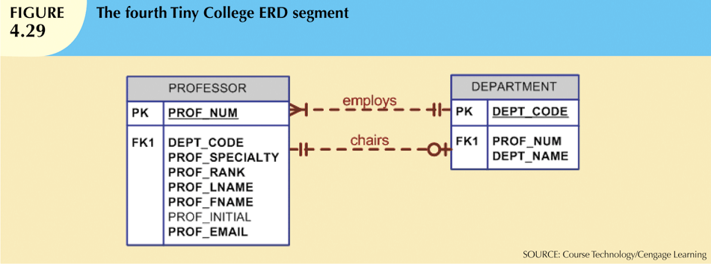

Slide 12
College Case Study
Nevertheless, it is worth repeating that a CLASS is a section of a COURSE. That is, a department may offer several sections (classes) of the same database course. Each of those classes is taught by a professor at a given time in a given place.
In short, a 1:M relationship exists between COURSE and CLASS. However, because a course may exist in Tiny College’s course catalog even when it is not offered as a class in a current class schedule, CLASS is optional to COURSE.

Slide 13
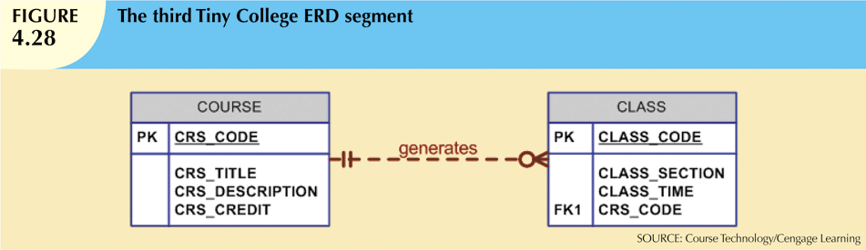
College Case Study

Slide 14
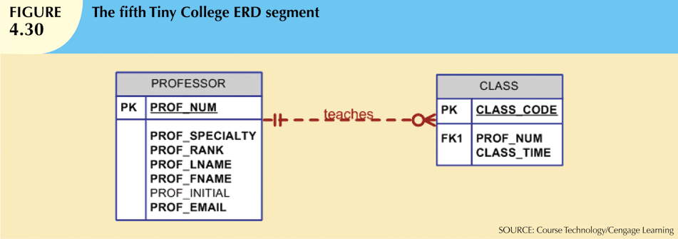
College Case Study
Each professor may teach up to four classes; each class is a section of a course. A professor may also be on a research contract and teach no classes at all.

Slide 15
College Case Study
A student may enroll in several classes but takes each class only once during any given enrollment period. For example, during the current enrollment period, a student may decide to take five classes—Statistics, Accounting, English, Database, and History—but that student would not be enrolled in the same Statistics class five times during the enrollment period! Each student may enroll in up to 6 classes, and each class may have up to 35 students, thus creating an M:N relationship between STUDENT and CLASS. Because a CLASS initially exist (at the start of the enrollment period) even though no students have enrolled in it, STUDENT is optional to CLASS in the M:N relationship.

Slide 16
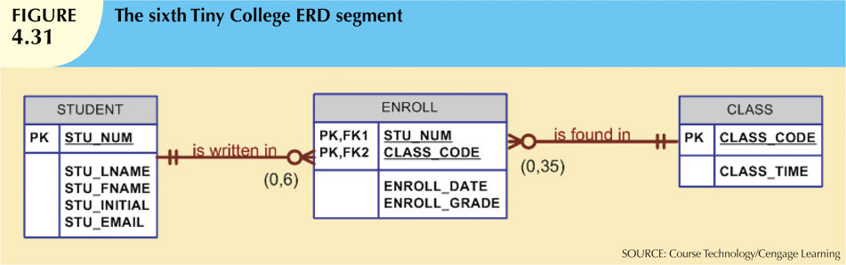
College Case Study

Slide 17
College Case Study
Each department has several (or many) students whose major is offered by that department. However, each student has only a single major and is, therefore, associated with a single department.
However, in the Tiny College environment, it is possible—at least for a while—for a student not to declare a major field of study. Such a student would not be associated with a department; therefore, DEPARTMENT is optional to STUDENT. It is worth repeating that the relationships between entities and the entities themselves reflect the organization’s operating environment. That is, the business rules define the ERD components.

Slide 18
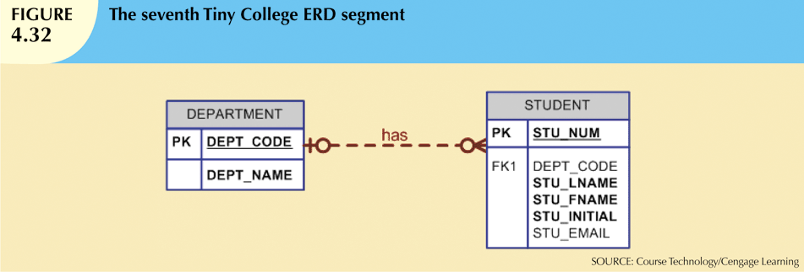
College Case Study

Slide 19
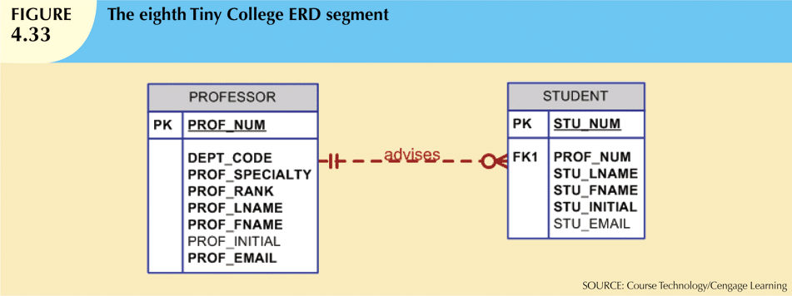
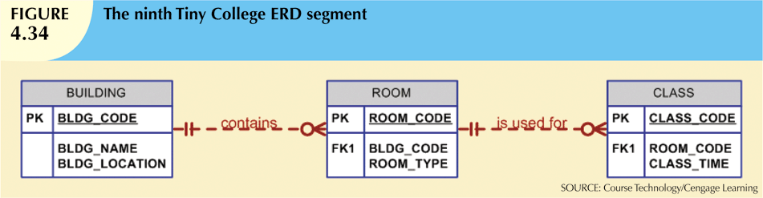

Slide 20
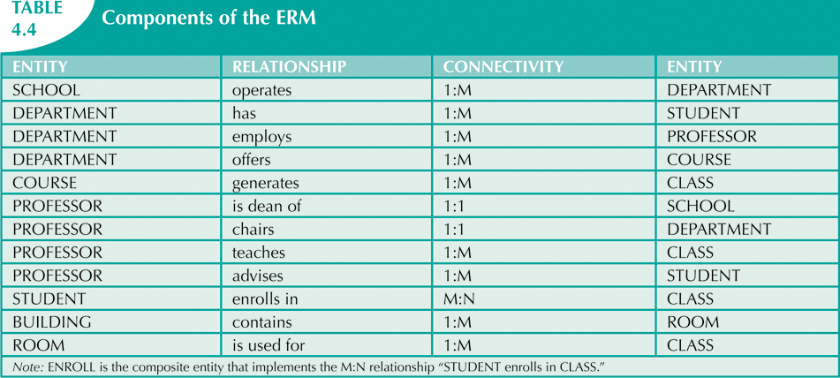
College Case Study

Slide 21
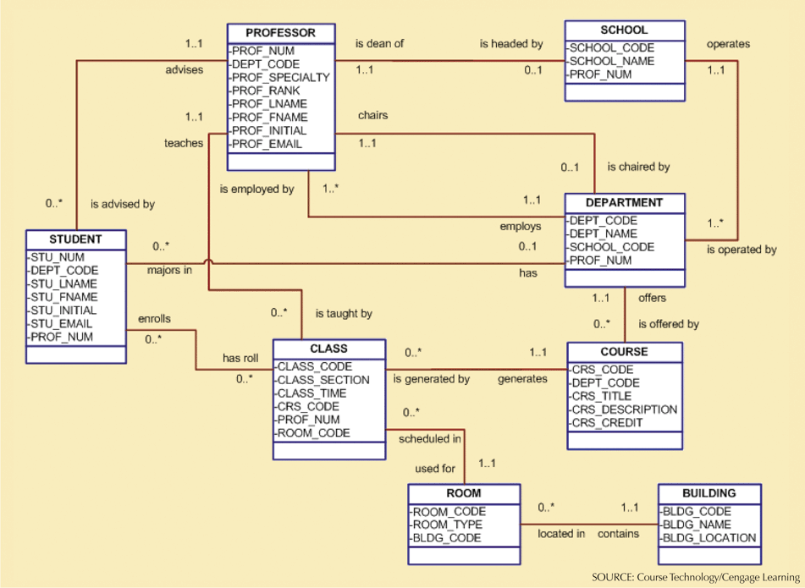

Slide 22
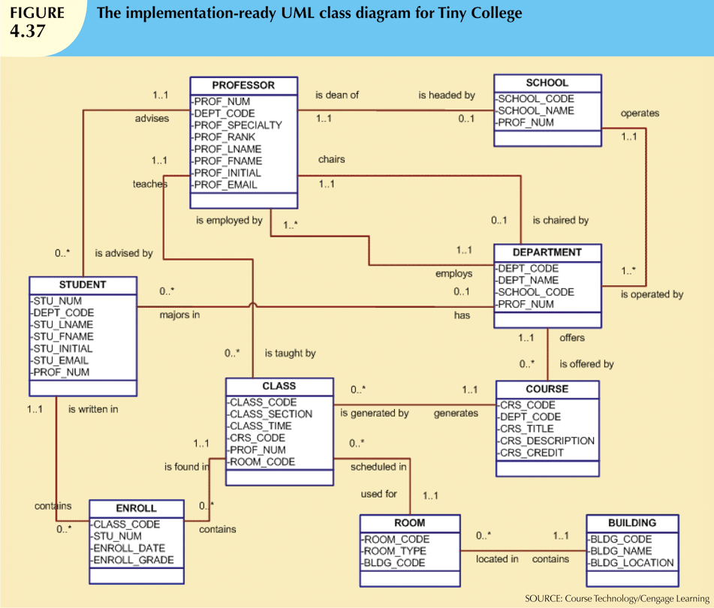

Slide 23

http://www.thomasformo.com/category/qa/

